Slide 1
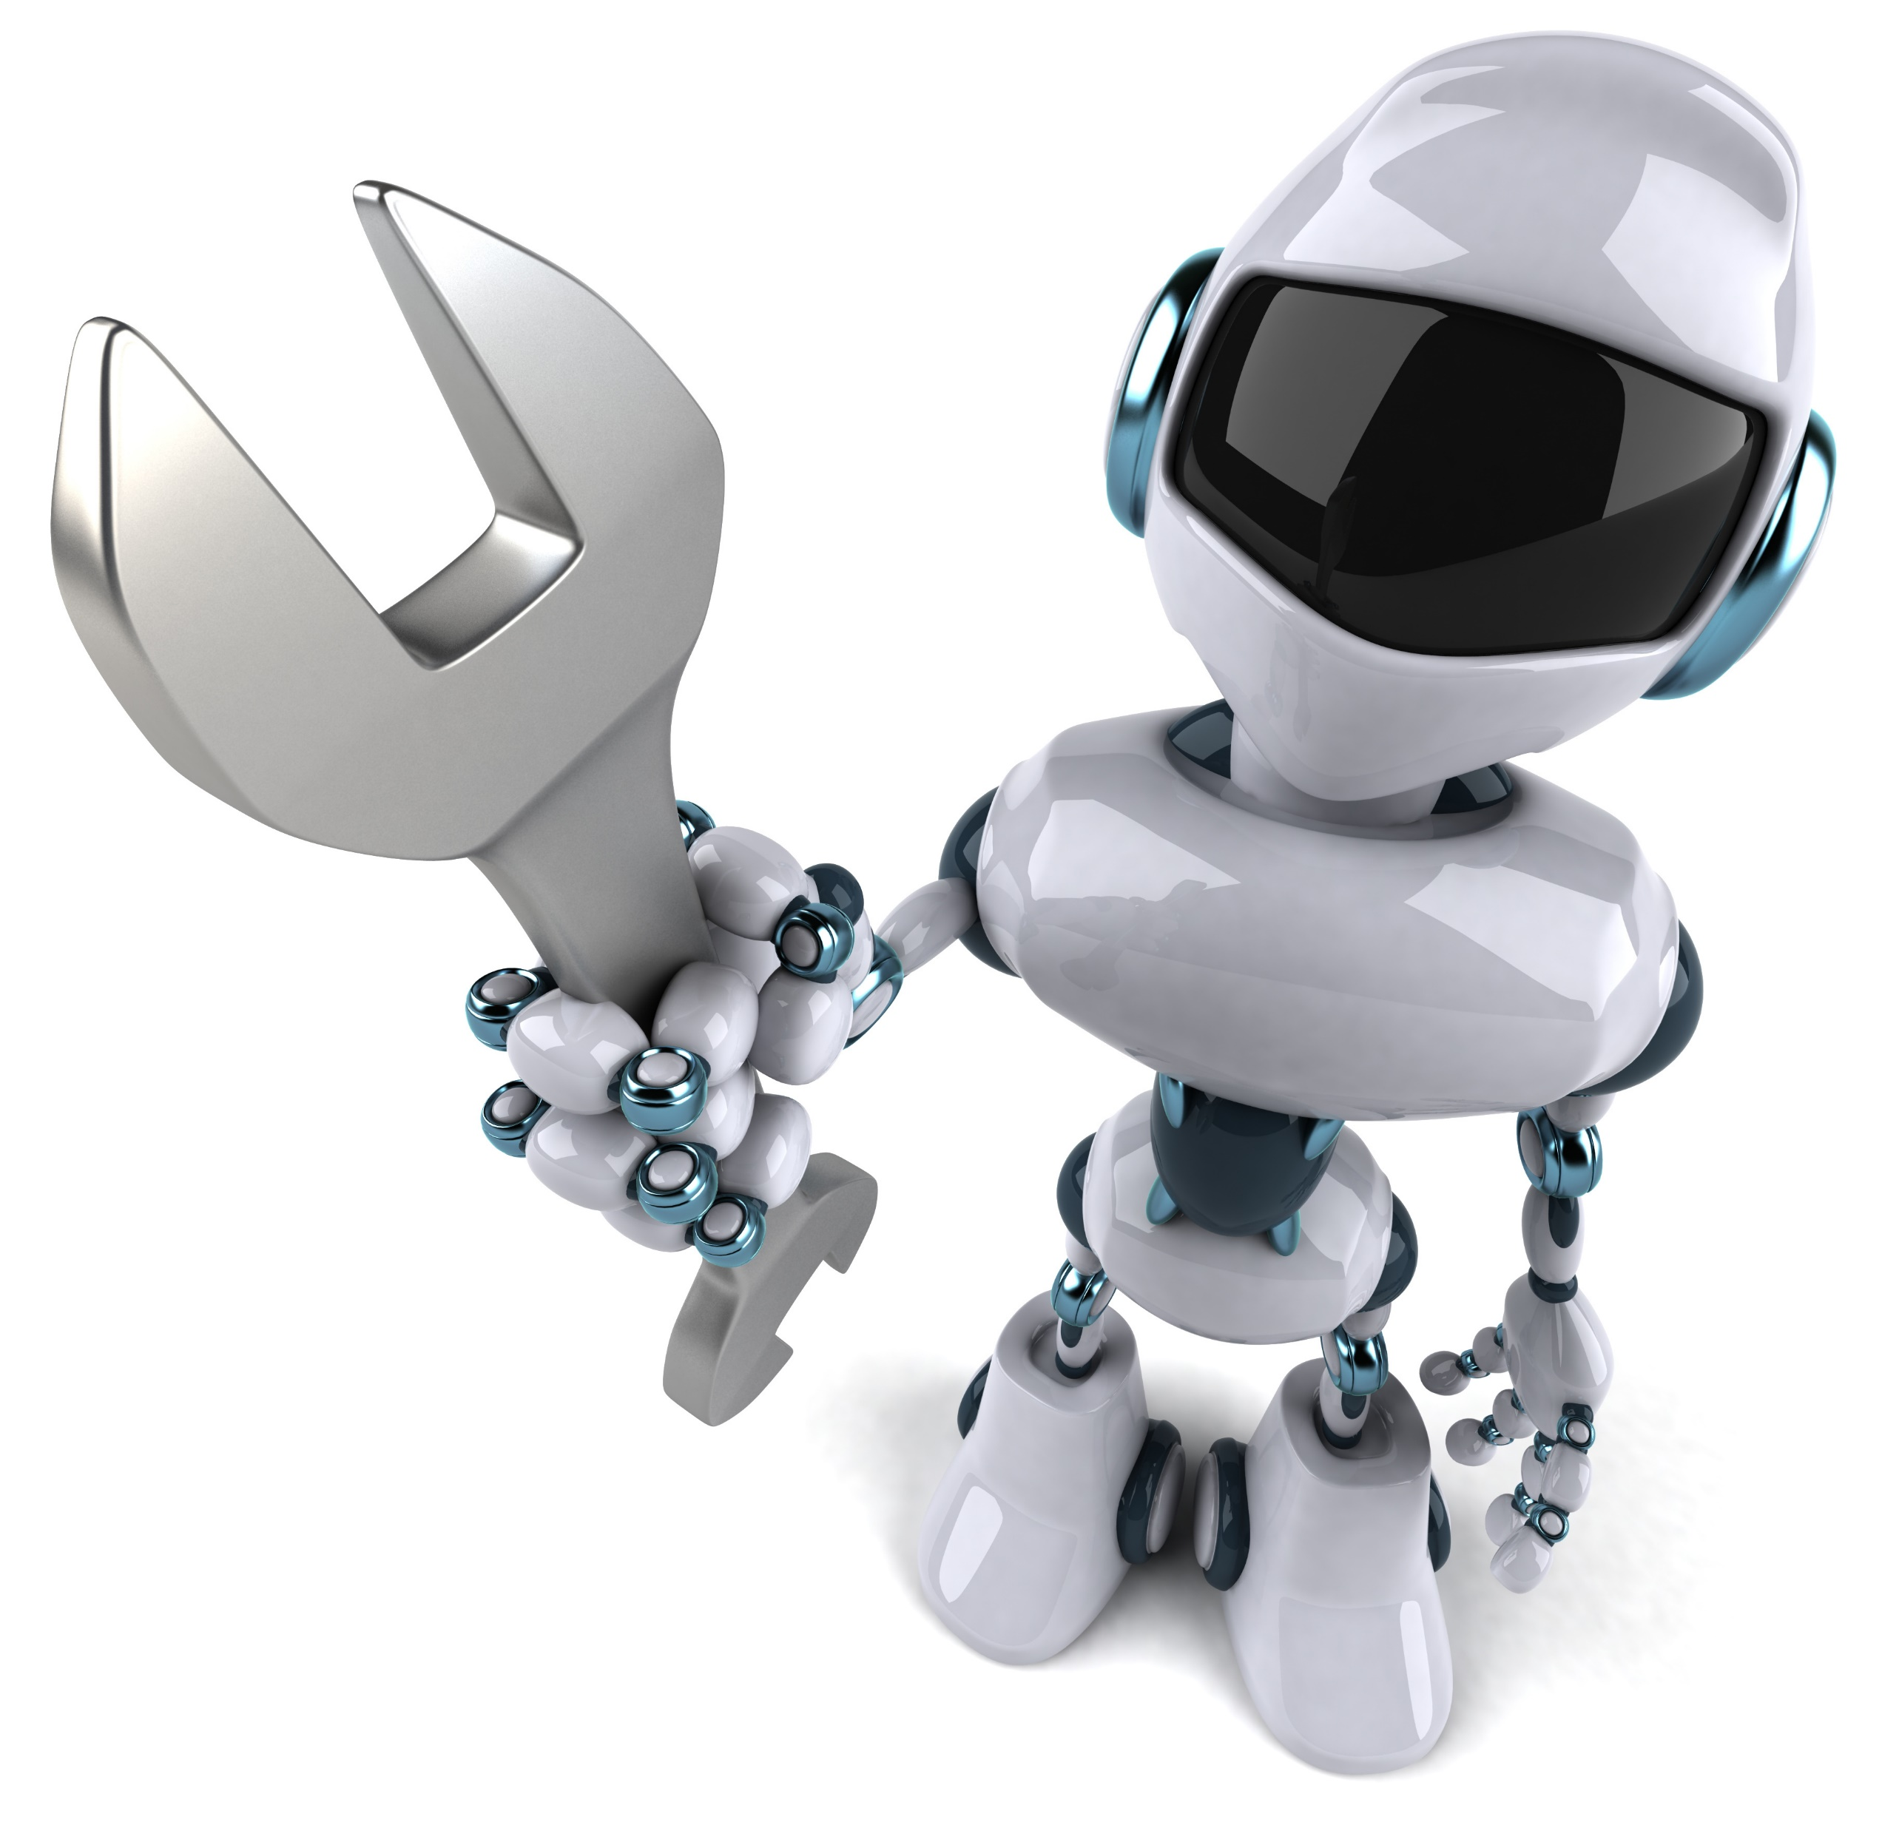
Introduction to Robotics
Rimvydas Rubavicius

Slide 2
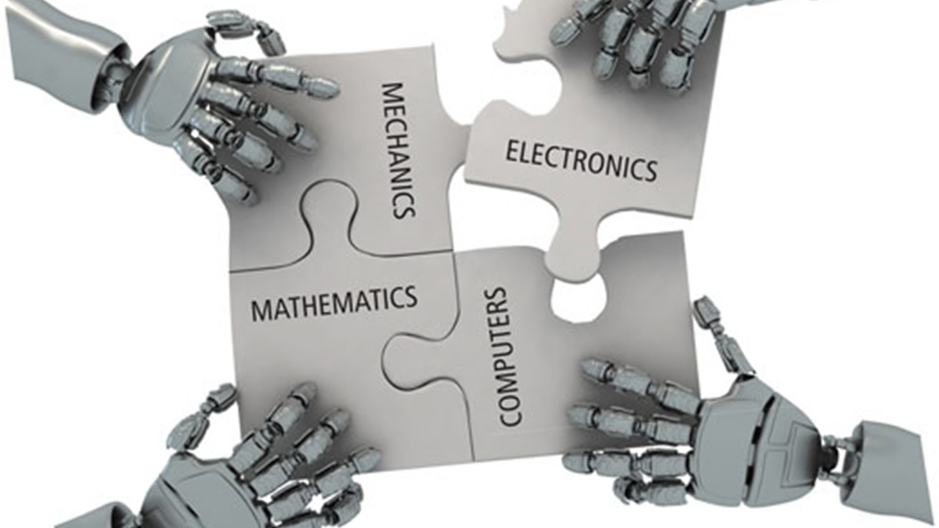
Elements of Robotics

Slide 3
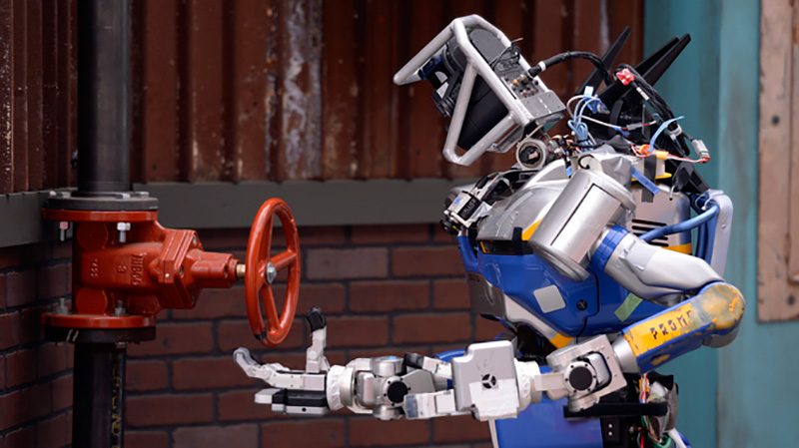
Why robotics is still hard?

Slide 4
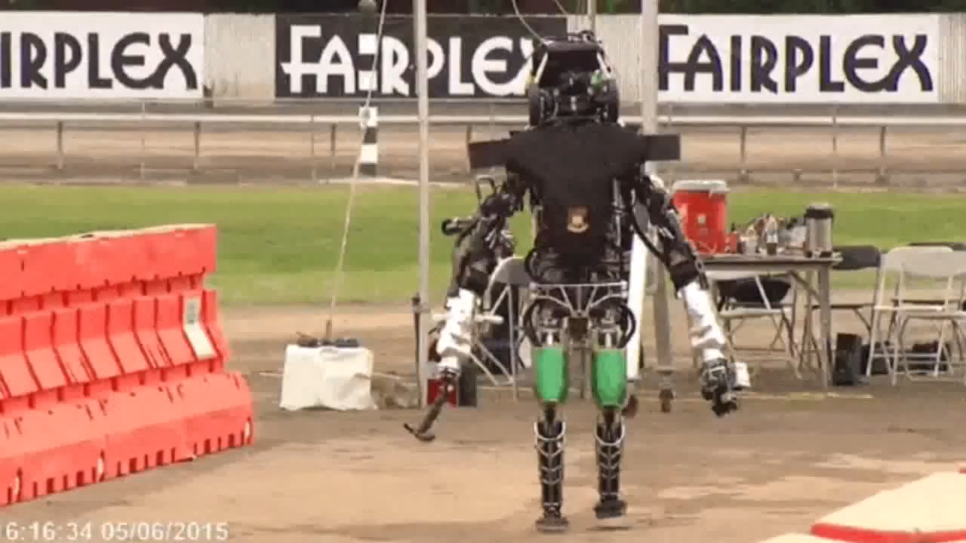
DARPA Robotics Challenge

Slide 5
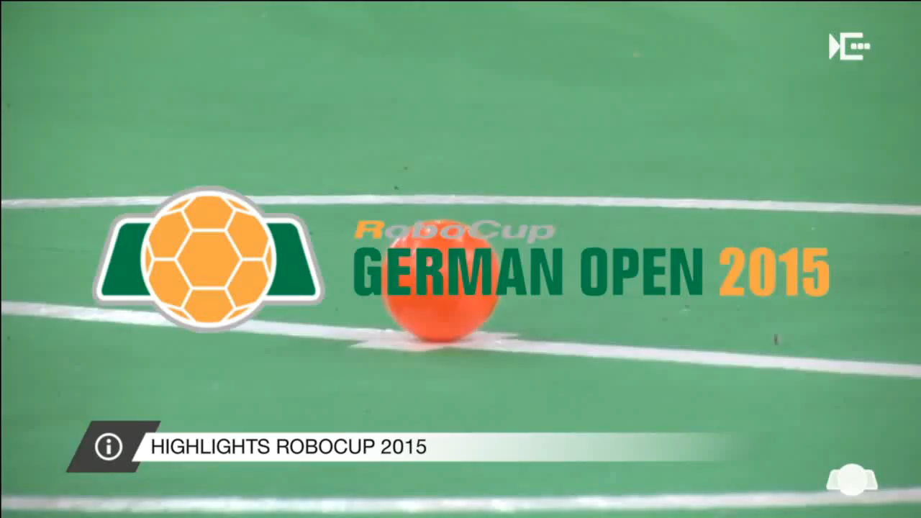
Sensing; RoboCup German Open 2015

Slide 6
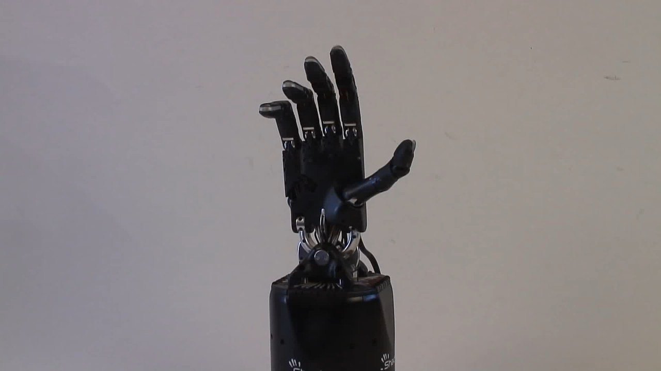
Manipulation; Shadow Hand

